Slide 1
6th Comptroller Squadron
Hurricane Evacuation Travel Entitlements
Version: April 2024
Contact Information:
Finance.services@us.af.mil
(813)828-5377

Slide 2
Entitlements
Mileage:
Limited to one round trip from the evacuated residence to safe haven location.
Annotate on travel voucher miles (block 15f) by tracking vehicle odometer(s).
Personally Owned Conveyance/Vehicle (POC/POV) limit is based on the number of age-eligible drivers on the claim.
Based off TDY rate of $0.67 per mile.
Per Diem:
First and last days are paid at 75% of locality rate.
Dependents ages 12+ receive 100% of the locality rate
Dependents ages 11 and below receive 50%
Lodging
For lodging you will be reimbursed total locality rate for member and dependents per night OR actual cost per night based on receipts. Whichever is lower.

Slide 3
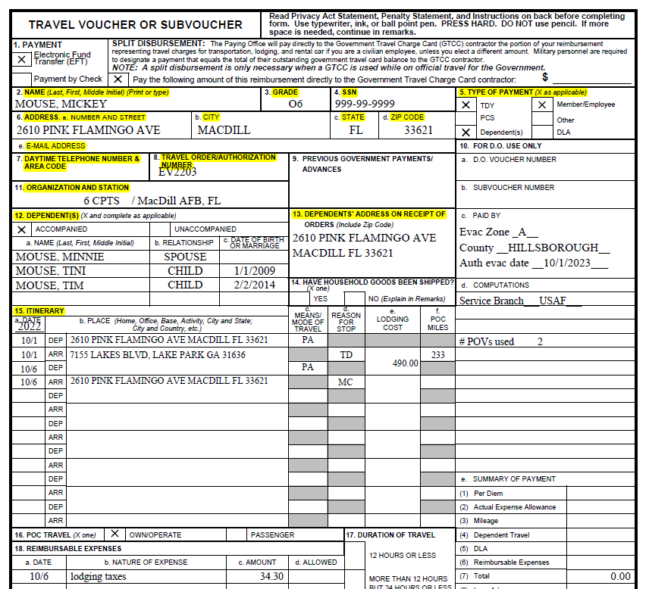
Travel Voucher Example
Mileage is calculated at TDY rate
1 Jan 2024: $0.67 per mile
Example:
233 miles x 0.67 = $156.11
Multiply this amount per authorized vehicle
Claim Lodging Cost in block 15e
Nightly rate X # of nights
Example:
$98/night X 5 nights = $490
Claim lodging taxes separately under block 18 “reimbursable expenses”
Must provide receipts for lodging

Slide 4
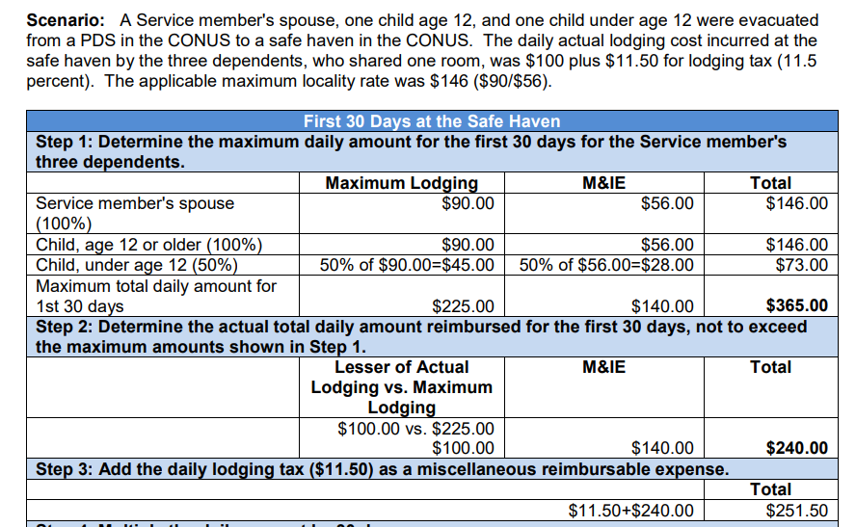
Daily Lodging Computation Example
Multiply Daily amount by number of days at Safe Haven location
Find More examples on DTMO website:
Computation Examples | Defense Travel Management Office (dod.mil)

